Slide 1










Methodology Framework
Layers available in dashboard:
1. Desertification Index
(consisting of 2-4)
2. Vegetation Index
3. Soil Quality Index
4. Climate Index
5. Population
6. Land Use Land Cover
7. Potential Planting Sites
(consisting of 2-3)
8. Great Green Wall extent
Workflow A1: Desertification Index (DI)
Desertification Index
[DI]
Vegetation Index
[NDVI]
Soil Quality Index
[SAVI]
Climate Index
[NDWI]
Workflow A2: Risk Identification
Workflow B: Tree Planting Site Identification
Desertification Index adapted from: https://www.eea.europa.eu/data-and-maps/figures/sensitivity-to-desertification-index-map
Additional services (cost to be discussed further):
Updates to Items 1 and 2 on a regular basis (quarterly/half-yearly/yearly)
Prediction and modelling

Slide 2
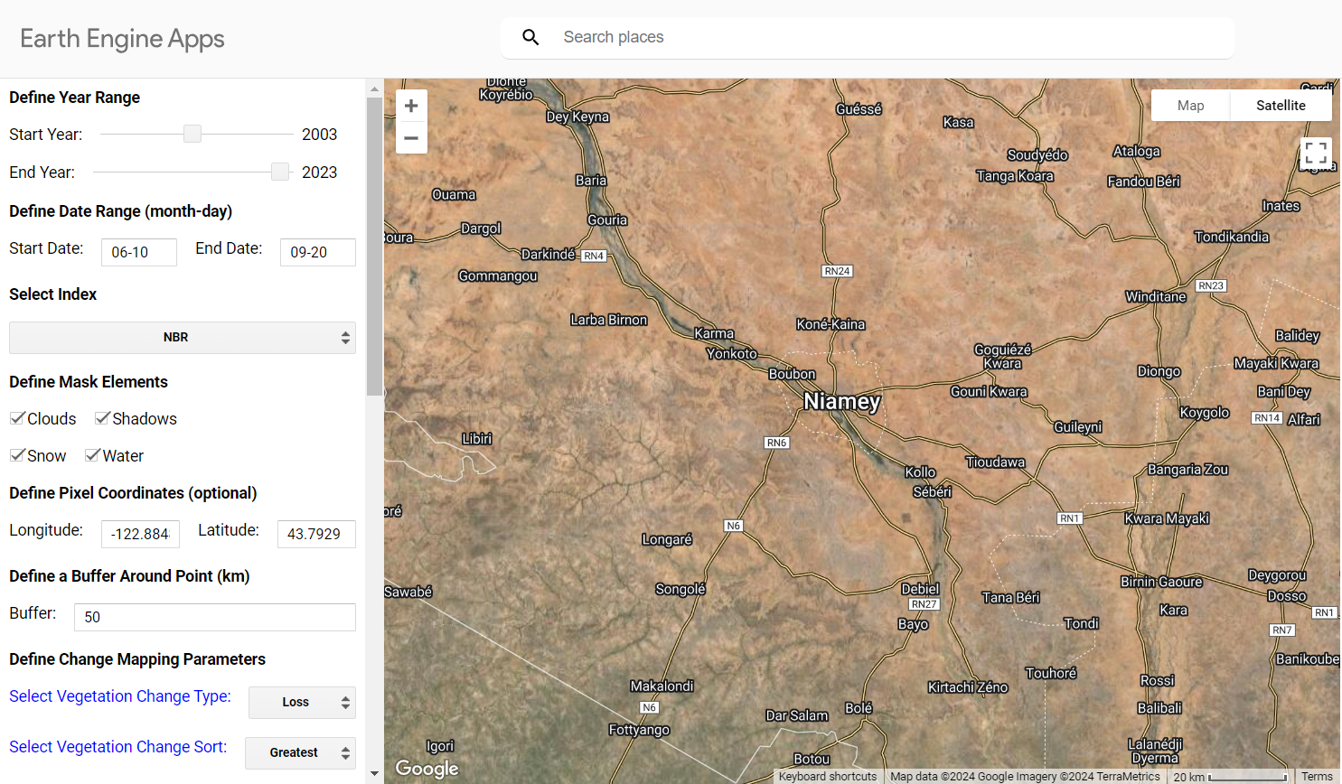
Sample Dashboard Preview
Select Time Range
Select Index
Desertification Index
NDVI
SAVI
NDWI
Select Area of Interest
By coordinates
By clicking on map
Other Dashboard Layers
Population
Land Use Land Cover
Potential Planting Sites
Great Green Wall extent
Source: https://emapr.github.io/LT-GEE/index.html

Slide 3
Desertification Dashboard
Share maps with relevant stakeholders (e.g. NGOs and local communities)
Consult with expert botanists to diversify crop and tree species for GGW planting
Confer with local herders and farmer communities to reconcile GGW planting areas
Present findings and provide dashboard access to relevant government bodies
Show severity of the situation to allocate more resources
Disclaimer: Engage this data only in conjunction with local intel on insurgence activities

Slide 4
Item | Quantity | Day Rate (￡) | No. of Days | Total Cost (￡)
Project Manager | 1 | 300 | 120 | 36000
Data Engineer | 1 | 250 | 90 | 22500
Geospatial Data Analyst | 2 | 225 | 90 | 40500
Environmental Scientist | 1 | 200 | 20 | 4000
Software Developer | 2 | 250 | 90 | 45000
UI/UX Designer | 1 | 200 | 60 | 12000
Field Surveyor | 2 | 150 | 30 | 9000
Government and Public Affairs | 1 | 200 | 120 | 24000
Total Manpower Cost |  |  |  | 193000
Lump Sum Misc. Cost (e.g. stakeholder engagement, transportation) |  |  |  | 10000
Contingency (10%) |  |  |  | 20300
Overall Cost |  |  |  | 223300

Slide 5
Additional Services | Cost
Botanist | To be discussed further subject to scope
Maintenance and Updates to Dashboard
Prediction and Modelling

